Slide 1
So Far
Now, familiar with
Order of running time
Big-Oh function
Amortized analysis
Vector and List
Storing elements in a linear fashion
Position
Containers and Iterators

Slide 2
Trees
Make Money Fast!
Stock Fraud
Ponzi Scheme
Bank Robbery

Slide 3
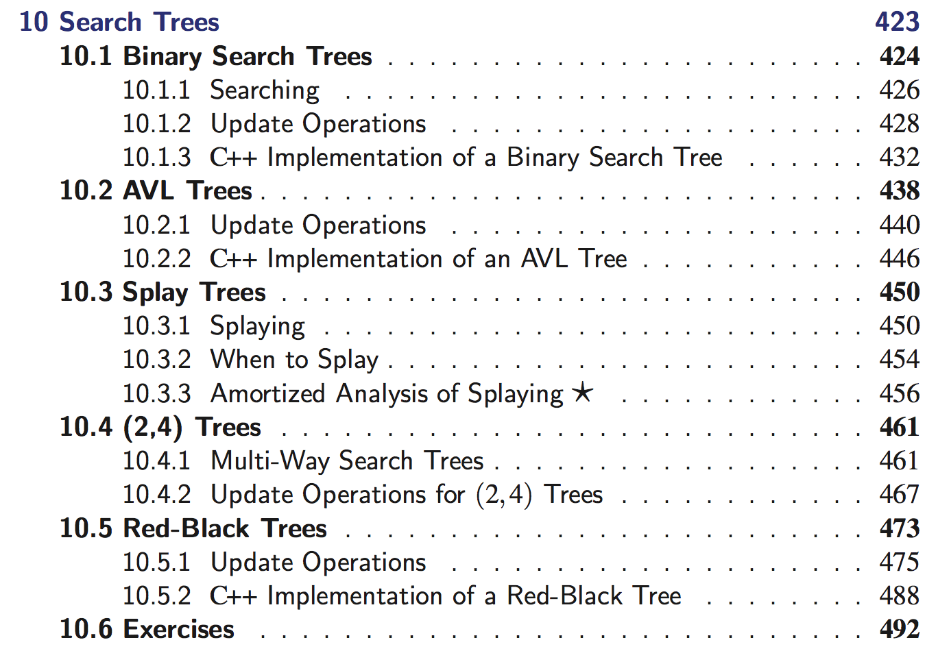
Summary
Reading: Chapters 7.1, 7.2, 7.3
This chapter: Basics
Later in Chapter 10, we will cover:

Slide 4
What is a Tree?
A graph without cycles
In software systems, a tree is an abstract model of a hierarchical structure
Compared with “linear” data structures
A tree consists of nodes with a parent-child relation
Applications:
Organization charts
File systems
Programming environments
Computers”R”Us
Sales
Manufacturing
R&D
US
International
Laptops
Desktops
Europe
Asia
Canada

Slide 5
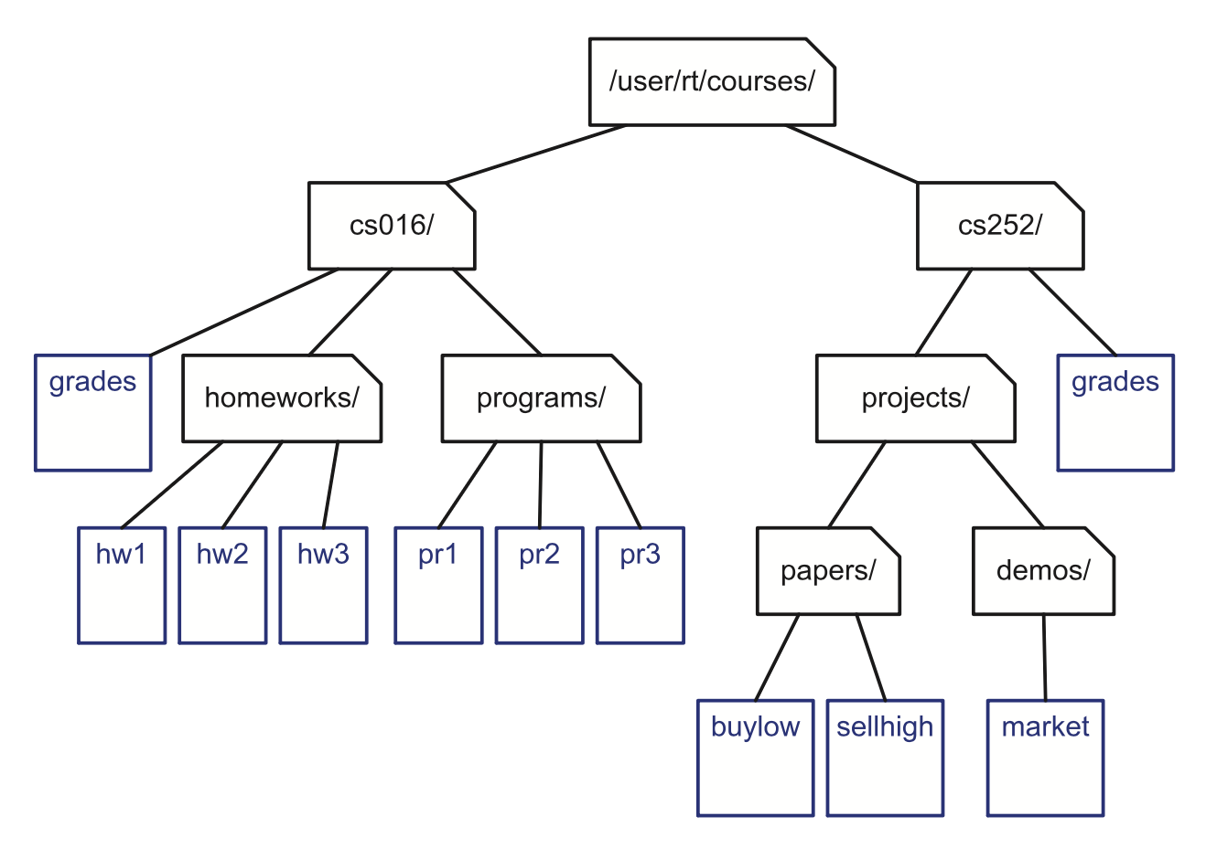
Example: File System

Slide 6
Tree Terminology
Root: node without parent (A)
Internal node: node with at least one child (A, B, C, F)
External node (a.k.a. leaf ): node without children (E, I, J, K, G, H, D)
Ancestors of a node: parent, grandparent, grand-grandparent, etc.
Depth of a node: number of ancestors
Height of a tree: maximum depth of any node (3)
Descendant of a node: child, grandchild, grand-grandchild, etc.
Subtree: tree consisting of a node and its descendants
A
subtree
B
C
D
E
F
G
H
I
J
K

Slide 7

Tree ADT
We can use positions to abstract nodes
Generic methods:
integer size()
boolean empty()
Accessor methods:
position root()
list<position> positions()
Position-based methods:
position p.parent()
list<position> p.children()
Query methods:
boolean p.isRoot()
boolean p.isExternal()
Additional “update” methods may be defined by data structures implementing the Tree ADT
Remove the node at some position
Swap a parent and its specific child
Etc …

Slide 8
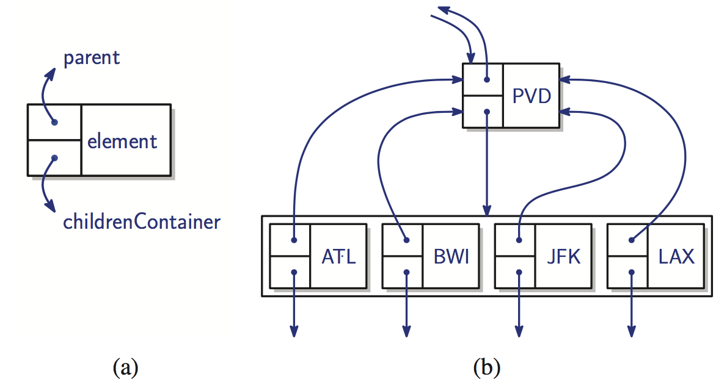
A linked structure for General Trees
One way of implementing a general tree

Slide 9
Tree Traversal Algorithms

Slide 10
Traversal Computations
1. Depth?
2. Height?
3. Visit every nodes
Preorder
Postorder
Inorder
These are the basic things to do for a given tree

Slide 11
Example: ”du” command
$> du –s . Print the aggregate file sizes from the current directory

Slide 12
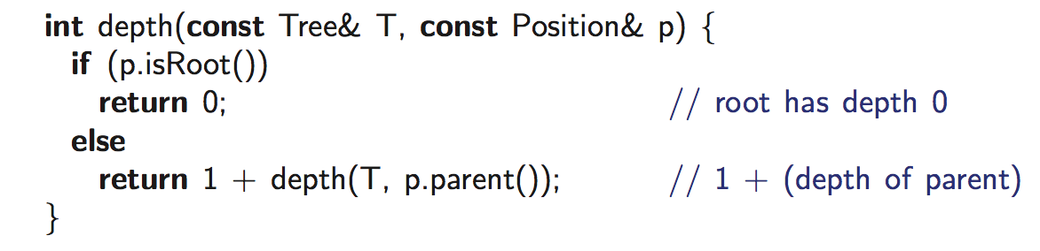
1. Depth of a node
Complexity? O(d_{p}), worst-case O(n)

Slide 13
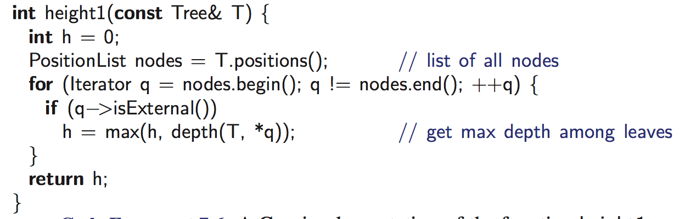
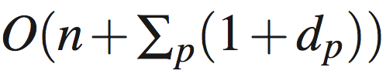
2. Height of a tree T: height1
Equal to the maximum depth of its leaves
OK. Then, what about this algorithm?
Complexity?
Worst-case: O(n²)

Slide 14
Two Trees
……
……
n-1 leaves
……
n/2 non-leaves
……
……
n/2 leaves

Slide 15
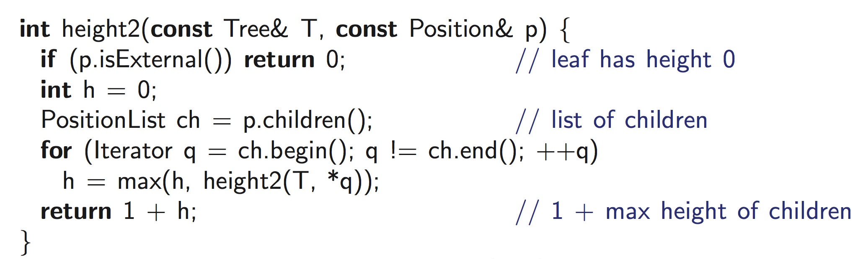
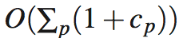
2. Height of a tree T: height2
Why is height1 inefficient?
Worst-case: O(n)

Slide 16
3. Preorder Traversal
A traversal visits the nodes of a tree in a systematic manner
In a preorder traversal, a node is visited before its descendants
Application: print a structured document
Algorithm preOrder(v)
visit(v)
for each child w of v
preorder (w)
1
Make Money Fast!
2
5
9
1. Motivations
2. Methods
References
3
4
6
7
8
1.1 Greed
1.2 Avidity
2.1 Stock Fraud
2.2 Ponzi Scheme
2.3 Bank Robbery

Slide 17
3. Postorder Traversal
In a postorder traversal, a node is visited after its descendants
Application: compute space used by files in a directory and its subdirectories
Algorithm postOrder(v)
for each child w of v
postOrder (w)
visit(v)
9
cs16/
8
3
7
homeworks/
programs/
todo.txt 1K
1
2
4
5
6
h1c.doc 3K
h1nc.doc 2K
DDR.cpp 10K
Stocks.cpp 25K
Robot.cpp 20K

Slide 18
3. Inorder Traversal
In an inorder traversal a node is visited after its left subtree and before its right subtree
Application: draw a binary tree
x(v) = inorder rank of v
y(v) = depth of v
Algorithm inOrder(v)
if ¬ v.isExternal()
inOrder(v.left())
visit(v)
if ¬ v.isExternal()
inOrder(v.right())
6
2
8
1
4
7
9
3
5

Slide 19
Binary Tree

Slide 20
Binary Trees
A binary tree is a tree with the following properties:
Each internal node has at most two children (exactly two for proper binary trees)
The children of a node are an ordered pair
We call the children of an internal node left child and right child
Alternative recursive definition: a binary tree is either
a tree consisting of a single node, or
a tree whose root has an ordered pair of children, each of which is a binary tree
Applications:
arithmetic expressions
decision processes
searching
A
B
C
D
E
F
G
H
I

Slide 21
Arithmetic Expression Tree
Binary tree associated with an arithmetic expression
internal nodes: operators
external nodes: operands
Example: arithmetic expression tree for the expression (2 × (a − 1) + (3 × b))
+
×
×
2
−
3
b
a
1

Slide 22
Decision Tree
Binary tree associated with a decision process
internal nodes: questions with yes/no answer
external nodes: decisions
Example: dining decision
Want a fast meal?
Yes
No
How about coffee?
On expense account?
Yes
No
Yes
No
Starbucks
Spike’s
Al Forno
Café Paragon

Slide 23
Properties of Proper Binary Trees
Notation
n number of nodes
e number of external nodes
i number of internal nodes
h height
Properties:
e = i + 1
n = 2e - 1
h ≤ i
h ≤ (n - 1)/2
e ≤ 2^{h}
h ≥ log₂ e
h ≥ log₂ (n + 1) - 1

Slide 24
BinaryTree ADT
The BinaryTree ADT extends the Tree ADT, i.e., it inherits all the methods of the Tree ADT
Additional methods:
position p.left()
position p.right()
Update methods may be defined by data structures implementing the BinaryTree ADT
Proper binary tree: Each node has either 0 or 2 children

Slide 25
Evaluate Arithmetic Expressions
Specialization of a postorder traversal
recursive method returning the value of a subtree
when visiting an internal node, combine the values of the subtrees
Algorithm evalExpr(v)
if v.isExternal()
return v.element()
else
x ← evalExpr(v.left())
y ← evalExpr(v.right())
◊ ← operator stored at v
return x ◊ y
+
×
×
2
−
3
2
5
1

Slide 26
How to represent trees in programming language?

Slide 27
Recall: Linked Structure for Trees
A node is represented by an object storing
Element
Parent node
Sequence of children nodes
Node objects implement the Position ADT
B
∅
A
∅
D
F
∅
B
A
D
F
C
E
C
∅
E
∅

Slide 28
Linked Structure for Binary Trees
A node is represented by an object storing
Element
Parent node
Left child node
Right child node
Node objects implement the Position ADT
∅
B
∅
∅
A
D
B
A
D
∅
∅
∅
∅
C
E
C
E

Slide 29
Array-Based Representation of Binary Trees
Nodes are stored in an array A
1
A
A
B
D
…
G
H
…
2
3
0
1
2
3
10
11
B
D
Node v is stored at A[rank(v)]
rank(root) = 1
if node is the left child of parent(node), rank(node) = 2 ⋅ rank(parent(node))
if node is the right child of parent(node), rank(node) = 2 ⋅ rank(parent(node)) + 1
4
5
6
7
E
F
C
J
10
11
G
H

